Slide 1
Wordle Coach
Team Odin

Slide 2
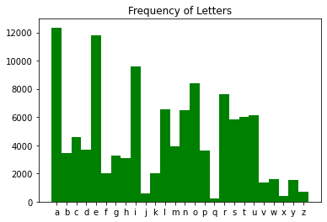
Wordle Solver Algorithm
Most Basic Functionality
Does not know the answer
Uses a preprocessed list of 14,855 potential wordle words
Uses letter frequency as a heuristic
Tries to pick the option that reveals the most information based on frequency
Eliminates words each round and analyzes the remaining word frequency
Robust and reliable
Fast
Expandable
https://github.com/tabatkins/wordle-list/blob/main/words

Slide 3
Major Functions
findLetterFrequency() On
getWordScores() On
pruneWords() On

Slide 4
findLetterFrequency()
Small.txt
scram
parts
flown
scrum
Letter 1 | Letter 2 | Letter 3 | Letter 4 | Letter 5
S | C | R | A | M
P | A | R | T | S
F | L | O | W | N
S | C | R | U | M
S = 50%
C = 50%
R = 75%
A,T,W,U = 25%
M = 50%

Slide 5
Letter 1 | Letter 2 | Letter 3 | Letter 4 | Letter 5
S | C | R | A | M
P | A | R | T | S
F | L | O | W | N
S | C | R | U | M
S = 50% | C = 50% | R = 75% | A,T,W,U = 25% | M = 50%
getWordScores()
S = 50% | C = 50% | R = 50% | A,T,W,U = 25% | M = 50%
Average Frequency
SCRAM = 50%
PARTS = 35%
FLOWN = 25%
SCRUM = 50%
Best Guesses: SCRAM, SCRUM
Small.txt
scram
parts
flown
scrum
S | C | R | A | M

Slide 6
pruneWords()
S | C | R | A | M
Letter 1 | Letter 2 | Letter 3 | Letter 4 | Letter 5
S | C | R | A | M
P | A | R | T | S
F | L | O | W | N
S | C | R | U | M

Slide 7
pruneWords()
Eliminates words by green letters
Eliminates yellow same column letters
Scans remaining word and removes any with black letters
With remaining set removes words with the full set of yellow letters

Slide 8
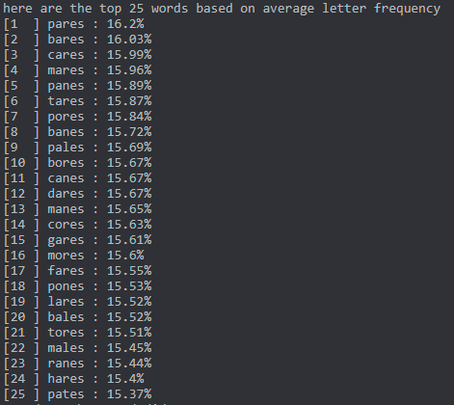

Slide 9
User Interface Design
Two “frame” app
Play wordle
Help screen
Character boxes to enter each character of the current guess
List of previous guesses
Toggle button to select the color of each letter
Bottom screen information display
Suggestions based on previously entered word
Probability of each suggested word being the wordle
Undo guess button
Start over button

Slide 10
Wordle Coach
Current Guess
C
R
A
N
E
90%
Probability listed of the guess being correct
Toggle buttons to select the color for each letter
Previous Guesses
1. crane
2.
3.
Old guesses will fill up as they get closer to guessing the word
4.
5.
Top 25 Next Probable Words
1 CHART 95% 4 CRANK 80%
2 CHAIR 90% 5 CRAZE 70%
3 CHAIN 85% 6 CAROL 50%
Users can see most probable words in groups of five
1-5
6-10
11-15
16-20
21-25
Undo Guess
Start Over
Buttons along the bottom. For the undo and start over buttons, a prompt will show up asking if the user is sure they want to do it.
? HELP
ENTER GUESS

Slide 11
Wordle Coach
Current Guess
C
R
A
E
90%
Probability listed of the guess being correct
Error:
Empty letter(s)
Toggle buttons to select the color for each letter
Previous Guesses
1. crane
2.
3.
Old guesses will fill up as they get closer to guessing the word
Please check that all letters are filled in
4.
5.
Top 25 Next Probable Words
1 CHART 95% 4 CRANK 80%
2 CHAIR 90% 5 CRAZE 70%
3 CHAIN 85% 6 CAROL 50%
Close
Users can see most probable words in groups of five
1-5
6-10
11-15
16-20
21-25
Undo Guess
Start Over
Buttons along the bottom. For the undo and start over buttons, a prompt will show up asking if the user is sure they want to do it.
? HELP
ENTER GUESS

Slide 12
Wordle Coach
Current Guess
R
R
Z
A
F
90%
Probability listed of the guess being correct
Toggle buttons to select the color for each letter
Previous Guesses
Word Not Found
1. crane
2.
3.
Old guesses will fill up as they get closer to guessing the word
Word is not found within the word list
4.
5.
Top 25 Next Probable Words
Close
1 CHART 95% 4 CRANK 80%
2 CHAIR 90% 5 CRAZE 70%
3 CHAIN 85% 6 CAROL 50%
Users can see most probable words in groups of five
1-5
6-10
11-15
16-20
21-25
Undo Guess
Start Over
Buttons along the bottom. For the undo and start over buttons, a prompt will show up asking if the user is sure they want to do it.
? HELP
ENTER GUESS

Slide 13
Challenges
Learning about kotlin/java android development
First time UI design (learning curve)
Linking the front end to the back end files

Slide 14
UI Development Steps
Develop physical interface of buttons and other controls in android studio
Includes standard wordle design
Additional features as noted
Develop java files to interact with buttons
The calls from the buttons need to be translated
Allow input text to fill wordle board
Pass data back and forth from back end java library of wordle algorithm
User input will be passed into back end algorithm and will receive an evaluation
Back-end will send back processed or stored data

